Slide 1
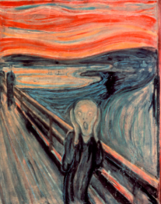
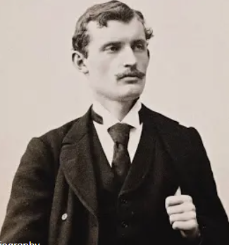
GGA Art Knowledge Organiser Year 4 – Autumn Term – Edward Munch The Scream
Key People
Edward Munch
Born: | 12th December 1863 Adalsbruk, Norway
Died: | 23rd January 1944
Known for: | Painting Expressionist painting Expressing his emotions through his artwork
Key Vocabulary and Definition
Artistic style | Edward Munch’s style is characterised by expressive colour and distorted forms, which helped him to convey the intense emotions he felt
Vocabulary | Expressionism Bold colours Cool colours
Outcomes
Pupils to recreate The Scream with pastels
Children could create their own artwork using a photograph of themselves in black and white and creating their own background displaying an emotion
Skills
Drawing with pastels | Creating a background
 | Creating a person outline
 | Merging of a person and a background
Colour | Use of bold colours to create mood, feeling and movement.
 | Use of orange and red to create a sense of unease and atmosphere
 | Use of cool colours such as blues, greys to create calmness or sadness
Why are we learning this?
The explore how we can use pastels to create a desired effect
Why is it important?
To develop an understanding of a range of artists and their artworks as well as the techniques they used

